Slide 1
Atomic Number and Mass

Slide 2
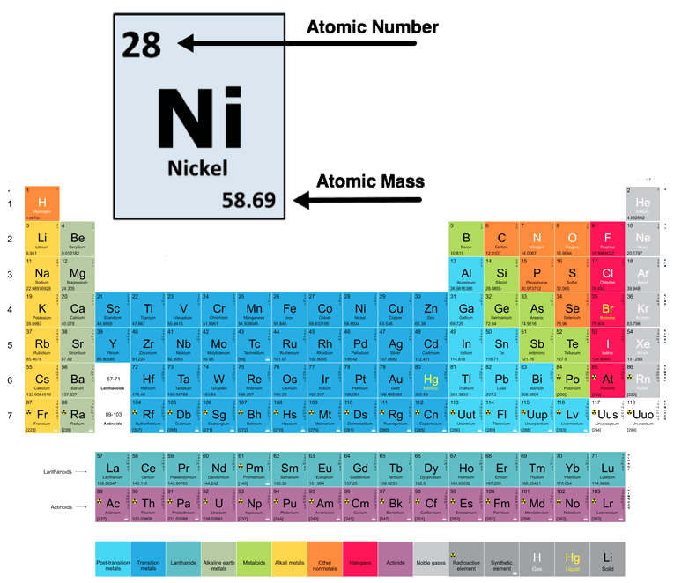
In this Smart Lesson you will learn to:
Define atomic number, mass number and atomic mass.
Calculate the number of protons, neutrons and electrons in an atom from atomic number and mass.
Recall the different types of nuclide families.

Slide 3
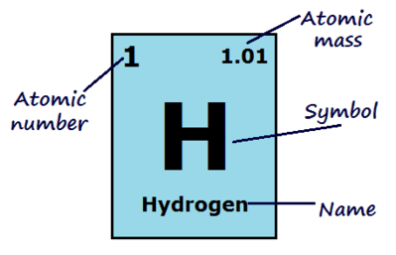
The atomic number of an atom is how many protons the nucleus has.
This is what defines an element! If an atom has 1 proton it is hydrogen, if it has 8 protons it is oxygen and if it has 94 protons it is plutonium.

Slide 4
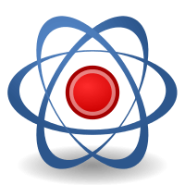
Atoms are neutral.
They have the same amount of electrons as protons, so the atomic number of an atom is also how many electrons it has.

Slide 5
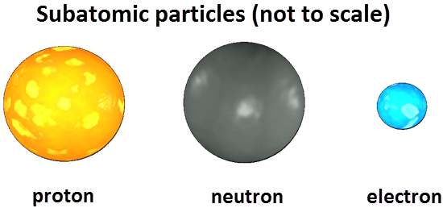
The mass number is the mass of one atom of an element.
It is the number of protons plus the number of neutrons in the nucleus of the atom.
Electrons are not considered when calculating the mass number because their mass is so small compared to protons and neutrons.

Slide 6

Because elements are only defined by the number of protons they have, they can have different numbers of neutrons.
Both neutrons and protons contribute to the mass of an atom, so different atoms of the same element can have different mass numbers.
Atomic mass is the average mass number of an element. Being a calculated average, the atomic mass is usually not a whole number. This is the value displayed on the periodic table alongside the atomic number.

Slide 7
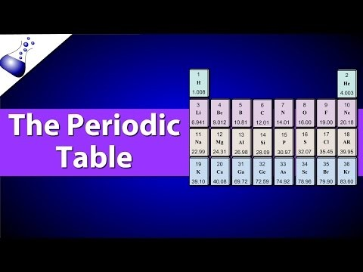

Slide 8
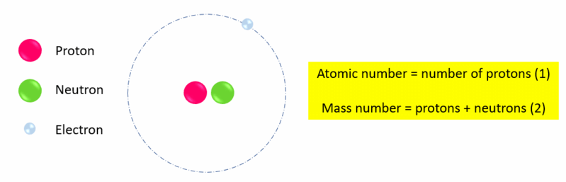
To find the number of neutrons in an atom, subtract the atomic number from the mass number:
mass number - atomic number = number of neutrons​
For example, the mass number (number of protons + neutrons) of one form of hydrogen could be 2, and the atomic number (number of protons) is 1. Therefore the number of neutrons in this hydrogen atom is 2−1=1.

Slide 9
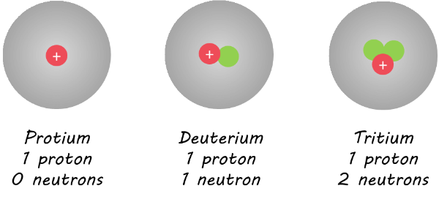
Nuclides.
Nuclides are defined as the range of atomic nuclei associated with a particular atom, which is defined by the atomic number and the various isotopes of that atom as identified by the mass number.
For example hydrogen can have the following nuclides:

Slide 10
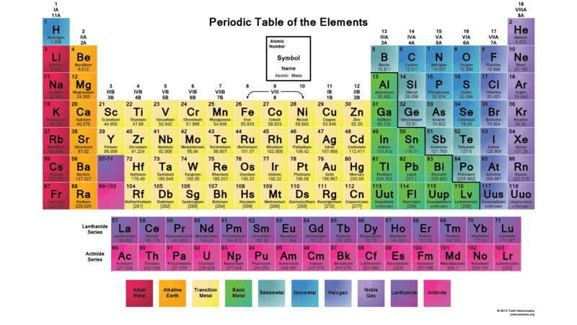
Organising nuclides.
We organise atoms into groups based on the number of protons and neutrons, and energy level of electrons.
There are several different nuclide families that we can organise atoms into.

Slide 11
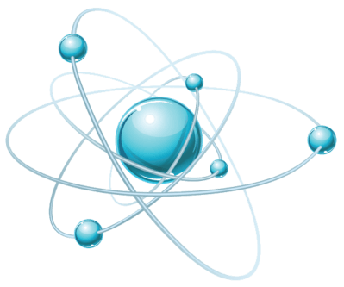
Nuclide families.
Isotopes all have the same number of protons, but vary in numbers of neutrons.
Isobars all have the same mass number. This does not necessarily mean that they have the same number of protons and neutrons.
Isotones have the same number of neutrons.
Nuclear isomers have the same number of protons and neutrons, but have different energy states.

